Slide 1

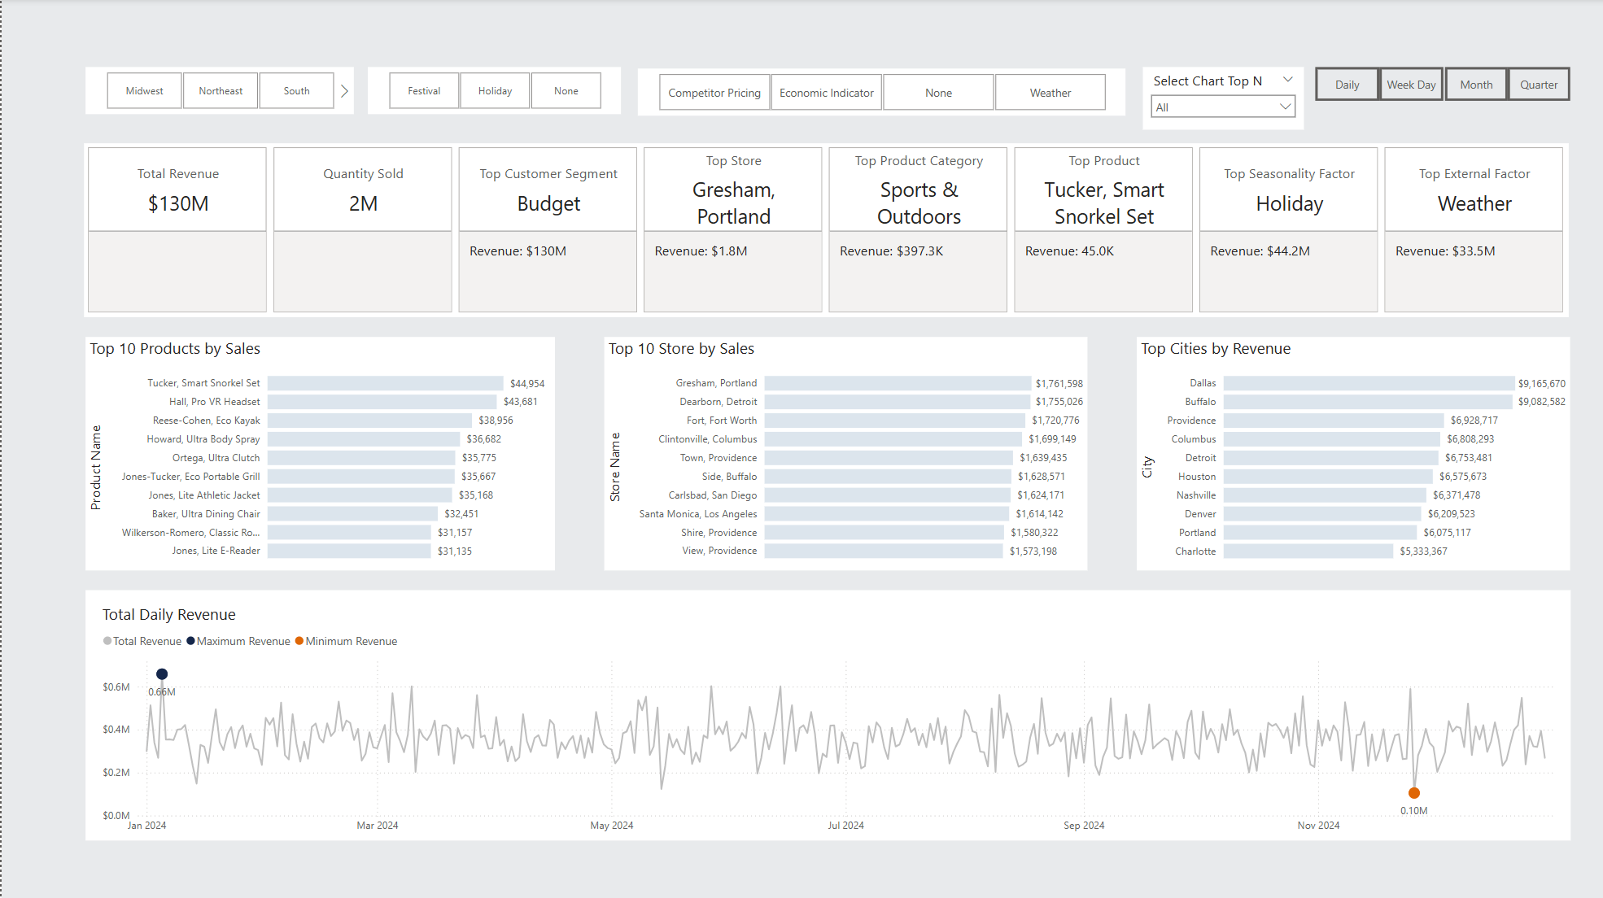
Mainstreet Mercantile - Sales Analysis - 2024
Tool Designed by Andrew Hubbard

Slide 2
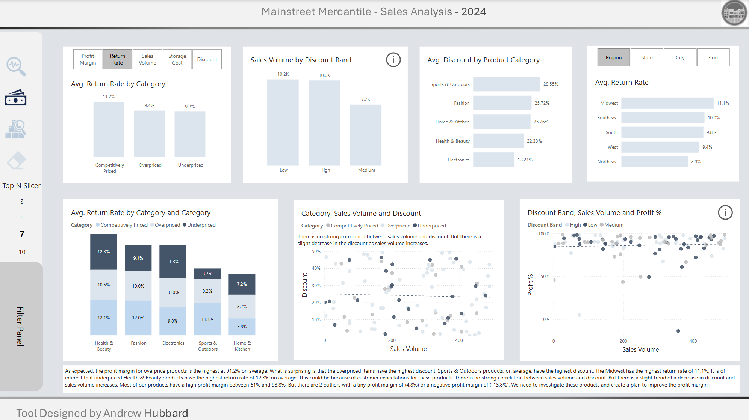
Mainstreet Mercantile - Sales Analysis - 2024
Tool Designed by Andrew Hubbard

Slide 3
Mainstreet Mercantile - Sales Analysis - 2024
Tool Designed by Andrew Hubbard

Slide 4

The Pixar Odyssey: 30 Years of Animation Magic
Interesting Facts About the Movie
Tool Designed by Andrew Hubbard

Slide 5









